Slide 1


Data-Driven Storytelling Presentation: Account Dynamics and Product Performance
(A 5-Year Review: 2017-2021)
Presenter:
Rasidat Yekeen

Slide 2
ACCELERATING GROWTH
Unveiling 5 Years of Product 1 Triumph.

Slide 3
Key point, observation or data
Critical analysis of the overall sales performance according to the data shows that the highest number of sales for product one was generated in the year 2021 (409194 units) while the lowest number of sales was generated in 2017 (189976). As a result, 2021 has the overall best in sales performance.

Slide 4
Key point, observation or data
Analysis shows that in the year 2021, Online Retailers generated the best sales unit and as a result, more resources can be pulled into it. However, resources being pulled into small businesses may be regulated due to their position as the least in terms of sales generation.

Slide 5
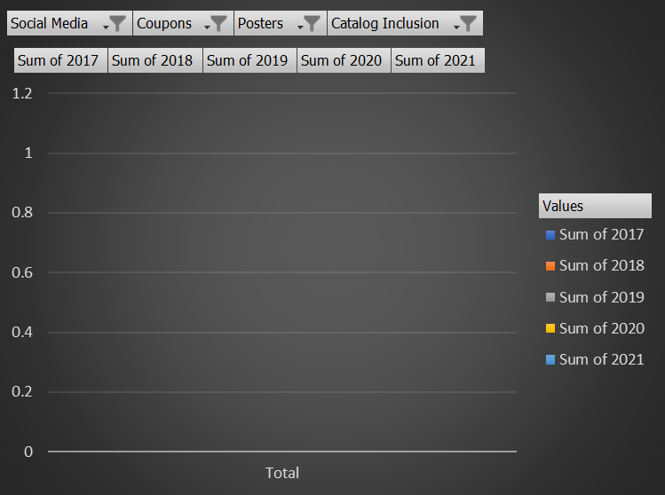
Key point, observation or data
Analysis shows that Poster as a means of marketing program is the least and a no-go area/platform due to the zero sales it has generated from 2017 till 2021.

Slide 6
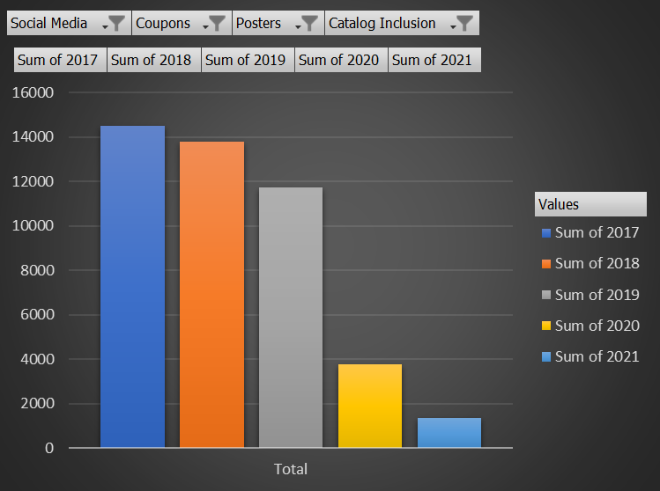
Key point, observation or data
Analysis shows that coupons marketing programs has shown a drastic reduction in effectiveness for the 5 years having the highest number of sales units in 2017 and the lowest in 2021.
Therefore, it’s not an effective marketing program that can be reconsidered.

Slide 7
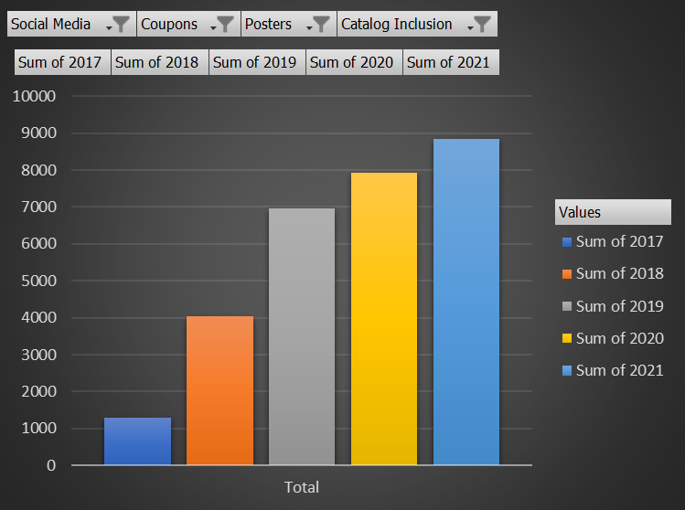
Key point, observation or data
Analysis shows that social media has been giving a steady but progressive increase in effectiveness from 2017 till 2021.

Slide 8
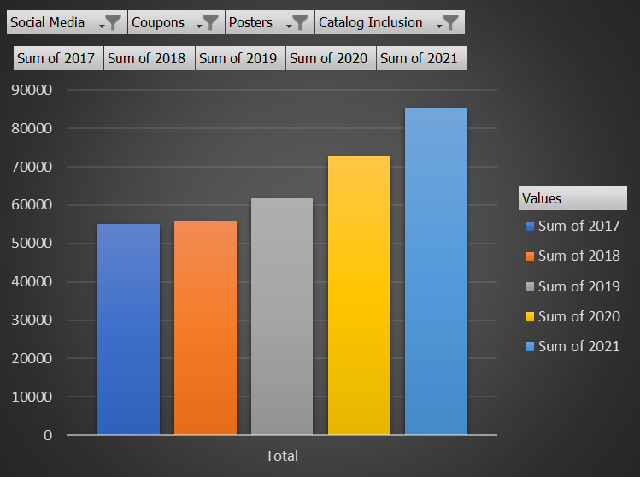
Key point, observation or data
Analysis shows that Catalog Inclusion has been the most effective marketing program right from the onset as it has been generating a significant sales volume and is still increasing in its sales generation. Therefore, it’s the most effective platform and more resources should be pulled into it.

Slide 9
Summary
2021 has the highest number of sales volume.
Online retailers generated the best sales volume and have been generating effectively from 2017 to 2021.
Poster should never be considered when considering marketing programs.
Coupons should also not be considered since it has been witnessing a drastic and continuous decrease from 2017.
Social media may be considered since it has been experiencing a steady and progressive increase since 2017.
Catalog Inclusion should definitely be considered since it has proven to be the most effective marketing program.

Slide 10
Thank You
Presenter:
Rasidat Yekeen

